Slide 1
Goal Striving and Motivation Regulation
EDUC 712: Advanced Study of Motivation
Week 12

Slide 2
Agenda
Brief overview of goal striving and motivation regulation (45-60 minutes)
5 minute break
Small Group Discussions (45-60 minutes)
Goal setting theory: Raleen
Implementation intentions: Ella
Motivation self-regulation: Kenneth and Lisa Jo
Agentic engagement: Tam and Valencia
5 minute break (complete group evals)
Whole group discussion (30-45 minutes)

Slide 3
Assignment House-Keeping
Final projects
Two-options: program development or research proposal
Group or individual
Narrow your scope to a few theories
At least 10 empirical references
6-8 pages, double spaced
Feedback on BlackBoard:
Five-ten sentences about the topic of your paper (and type of paper)
Submit on Nov. 19 (on BlackBoard):
Outline of your paper and list of references

Slide 4
Goals and Goal Setting

Slide 5
What are goals?
Last week: Goals as orientations or reasons
This week: Goals as targets or standards: standard one is striving to accomplish

Slide 6
Discrepancy is a motivator
Plans for discrepancy reduction between reality and ideals (Miller)
Test – Operate – Test – Exit (TOTE)
Contemporary approach to goals and plans
Adjustable/revisable
Discrepancy reduction -- corrective motivation/prevention focus
Discrepancy creation -- growth motivation/promotion focus

Slide 7
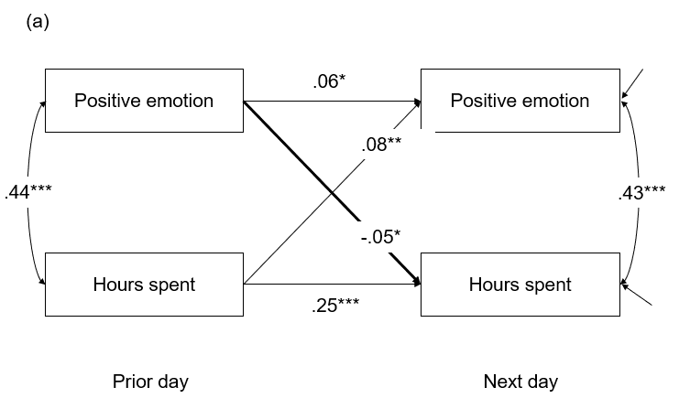
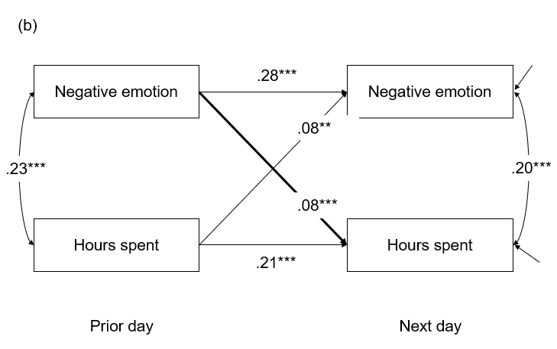
Emotions are key to goal pursuit…
Positive emotions one day predicts less goal pursuit on the next day among college students.
Negative emotions one day predict more goal pursuit on the next day among college students, particularly for students with high self-control.
Seo & Patall (submitted for publication).

Slide 8
Goal setting
Goal setting = discrepancy creation → better performance
Factors that influence effectiveness goal setting
Difficulty
Specificity
Feedback
Acceptance and commitment
Complexity
Limitations

Slide 9
Implementation intentions

Slide 10
Goal striving failure
Weak link between intentions and attainment
How to address?
Goal striving literature: Specific goals better than vague goals
Social cognitive theory: Proximal goals better than distal goals
Regulatory focus: Promotion goals better than prevention or need for match approach with the goal (?)
Achievement goal orientations: Mastery/learning goals more effective than performance (?)

Slide 11
Implementation intentions
Another solution to goal striving failure → Implementation intentions, what are they?

Slide 12
Implementation intentions
Another solution to goal striving failure → Implementation intentions, what are they?
Why do the work? For who?
Automaticity, situational cues, getting started, persisting
Findings from Gollwitzer meta-analysis?
For which goals do they work? (Seo, Patall, & Henderson, 2017)

Slide 13
Implementation intentions are good for which goals?
For college students who set their own performance and completion (deadline) goals, implementation intentions enhance goal commitment, effort, and performance
For college students who had performance and completion goals assigned to them, implementation intentions had no benefit
Seo, Patall, & Henderson (2017) Journal of Experimental Education

Slide 14
Regulating Motivation

Slide 15
When goal pursuit starts to fall apart…Regulate

Slide 17
Regulating Motivation (Collaboratively) in Class

Slide 18
The power of agentic engagement (Thanks Johnmarshall Reeve!)
Simplified conceptual model of motivation and engagement (in science)
Agentic engagement: students’ proactive, constructive attempts to assert agency and influence the flow of instruction
Hypothesis: Students will experience an increase in need satisfaction, autonomy support, and other forms of engagement (relative to the prior class day), on days they agentically engage more than (their own) average
N = 208 high school science students (ages 14-18) (41 classes)
(55% female, 59% racial minority, 42% free/reduced lunch)
participated in a 6-week diary study

Slide 19
Effects (standardized coefficients) of Agentic Engagement on Changes in Daily Autonomy Support, Autonomy Need Satisfaction, and Other Engagement
Daily Predictors
Daily Outcomes
.15***
Autonomy support
Agentic engagement
.05**
Autonomy
Behavioral engagement
.09***
Behavioral engagement
Emotional engagement
.08***
Emotional engagement
Cognitive engagement
Cognitive engagement
Note. Three-level (day, student, class) multilevel random intercept only models used to test hypotheses. Standardized coefficients are presented. All models controlled for class type, teacher experience, student age, student ethnicity, student free/reduced lunch eligibility, prior unit course grade, time, outcome on the prior day.
Patall, Pituch, Steingut, Vasquez, Yates, & Kennedy (2019). Journal of Applied Developmental Psychology

Slide 20
Effects (standardized coefficients) of Agentic Engagement on Changes in Daily Autonomy Support, Autonomy Need Satisfaction, and Other Engagement
Daily Predictors
Daily Outcomes
Autonomy support
Agentic engagement
.14***
Autonomy
Behavioral engagement
-.02
Behavioral engagement
.30***
Emotional engagement
Emotional engagement
.06***
Cognitive engagement
Cognitive engagement
Note. Three-level (day, student, class) multilevel random intercept only models used to test hypotheses. Standardized coefficients are presented. All models controlled for class type, teacher experience, student age, student ethnicity, student free/reduced lunch eligibility, prior unit course grade, time, outcome on the prior day.
Patall, Pituch, Steingut, Vasquez, Yates, & Kennedy (2019). Journal of Applied Developmental Psychology

Slide 21
Effects (standardized coefficients) of Agentic Engagement on Changes in Daily Autonomy Support, Autonomy Need Satisfaction, and Other Engagement
Daily Predictors
Daily Outcomes
Autonomy support
Agentic engagement
Autonomy
Prior behavioral engagement
.27***
.33***
Behavioral engagement
Prior emotional engagement
.24***
.19***
Emotional engagement
.19***
Prior cognitive engagement
.28***
Cognitive engagement
Note. Three-level (day, student, class) multilevel random intercept only models used to test hypotheses. Standardized coefficients are presented. All models controlled for class type, teacher experience, student age, student ethnicity, student free/reduced lunch eligibility, prior unit course grade, time, outcome on the prior day.
Patall, Pituch, Steingut, Vasquez, Yates, & Kennedy (2019). Journal of Applied Developmental Psychology

Slide 22
Effects (standardized coefficients) of Agentic Engagement on Changes in Daily Autonomy Support, Autonomy Need Satisfaction, and Other Engagement
Daily Predictors
Daily Outcomes
Autonomy support
Agentic engagement
Autonomy
Prior behavioral engagement
.27***
.33***
Behavioral engagement
Prior emotional engagement
.24***
.19***
Emotional engagement
.19***
Prior cognitive engagement
.28***
Cognitive engagement
Reverse models with behavioral, emotional or cognitive engagement predicting changes in agentic engagement are significant, but weaker (β = .09 to .14)
Note. Three-level (day, student, class) multilevel random intercept only models used to test hypotheses. Standardized coefficients are presented. All models controlled for class type, teacher experience, student age, student ethnicity, student free/reduced lunch eligibility, prior unit course grade, time, outcome on the prior day.
Patall, Pituch, Steingut, Vasquez, Yates, & Kennedy (2019). Journal of Applied Developmental Psychology

Slide 24
And when we teach students to be agentically engaged…
Agentic engagement Intervention
vs.
Study skills intervention
Agentic Engagement Mindset
.24**
.22***
Perceived autonomy support
.16*
.48***
Behavioral engagement
.47***
.34***
.31***
.45***
Emotional engagement
Agentic Engagement
.32***
.25***
Cognitive engagement
.25***
.30***
Autonomy
Sample: 163 psychology college students (78% female; 45% White, 35% Asian, 12% Latinx, 6% Black)
.24**
.24**
Personal interest

Slide 25
Key questions to think about…
What are the implications of these various goal striving and motivation regulation theories and findings for applied settings?
Do you see these theories being realized in the settings in which you work?
Are they useful for promoting desirable and equitable outcomes among diverse learnings and across varied contexts?
What are the potential limitations of using the findings?
Other insights to come from group discussions?
DISCUSSION GROUP CHALLENGE: Create a list of actions/deliverables you could use in your organizations based on this weeks readings.

